Slide 1
Intro
Notes:
In the previous video we introduced the logistic regression model for classification problems.
Let’s recall that our original motivation for doing this was to classify iris flowers into three categories according to the length and width of their sepals and petals.
So far however we have only considered classification into two categories according to a single measurement.
In this video we will take the next step, and learn how to incorporate all four measurements into the model.

Slide 2
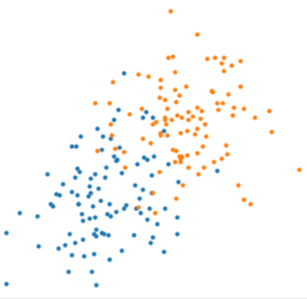
Data set
Notes:
We’ll begin with two features, X1 and X2.
The dataset is a collection of capital N samples, and each sample has values x1i and x2i, and a categorical value yi.
We can plot the data in the x1/x2 plane and color each sample according to its category yi.

Slide 3
Notes:
Now consider a new uncategorized sample x shown here as a green dot.
How shall we decide whether to classify x as orange or blue?
We can do the same thing as last time: that is, we can draw a small box around the new sample, count the number of blue and orange dots inside the box, and then decide by majority vote.

Slide 4
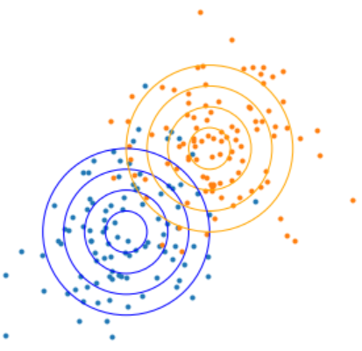
Notes:
To formalize this strategy, let’s again assume that the marginal distributions of the orange and blue classes are Gaussian and with equal covariance matrices capital Sigma, and furthermore that Sigma is diagonal.

Slide 5




Notes:
The same formula for the log odds from the one-dimensional case still applies here in the two dimensional case, except that now the terms are vector-valued.
The notation for the elements of x, mu1, mu2, and capital sigma are shown here.

Slide 6
Notes:
After some tedious algebra we arrive at this complicated formula for the log odds.
But the details are not the point here. The point is that the form of the log odds is identical to what we found in the single input case.
The log odds are again a linear combination of the inputs with an intercept term beta 0 and coefficients beta 1 and beta 2 for the two inputs
The fact that we made some very unrealistic assumptions to derive this formula is not very important, because we will not use this formula going forward. Again we will rely on the machinery of optimization to find the parameters.
,This result gives us a path forward. To add even more input features, all we need to do is add more linear terms to the log odds.

Slide 7



The betas are found by solving:
Notes:
And so we arrive at the general statement for two class logistic regression with capital M inputs.
Keep in mind that the random variable X is now multi-dimensional, and lower case x is a vector-valued sample.
The result is that the probability that a sample x is of class Y=1 equals the logistic function, sigma of x, where z is a linear combination of the M features with coefficients beta 0 through beta M.
And the betas are found, just as before, by minimizing the cross-entropy.

Slide 8
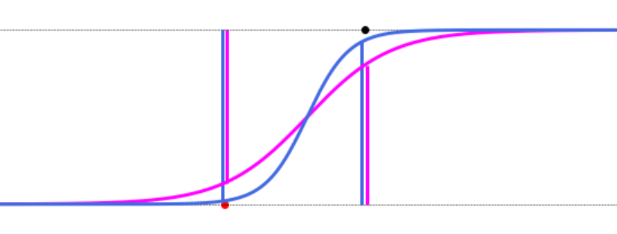
Notes:
Next we are going to address a common problem with logistic regression. We will illustrate this in the single feature case, but it shows up with multiple features as well.
Imagine you have a dataset where there is no overlap between the two classes. That is, there exists a threshold that exactly splits the data with perfect accuracy. What will the optimization problem do in this case?
Well, let’s consider two candidate solutions: sigma A in pink and sigma B in light blue color.
To evaluate the likelihood of each of these, we need to take the product of the probabilities of each data point, which are the heights of the vertical blue and pink lines in the figure.
And so we see that sigma B must have a higher likelihood than sigma A because in every case the vertical lines are longer.
But we could then take it one step further to a sigma C that is even steeper than sigma B, and then to sigma D, and so forth, ad infinitum.

Slide 9
Notes:
In this case, there is no solution to the optimization problem
With each iteration of the optimizer, the coefficients beta0 and beta1 will continue to grow without bound, and the solution will converge toward an infinitely steep step function, like the one indicated here as sigma infintiy
This bad situation was caused by the fact that the data is cleanly separable. And it is unfortunate, because separable data should be the easiest case to solve, and it shouldnt cause the algorithm to explode.
To address this problem, we can add a regularization term to the cost function, to penalize large coefficient values.

Slide 10


L1 or LASSO regularization:
L2 or Ridge regularization:
Notes:
You’ve already learned about regularization, so I won’t go into it deeply here.
I will just mention that we can use either L1 regularization or L2 regularization to fix this problem.
Both of these amount to appending a term to the cross entropy cost function. In the L1 or LASSO case it is a sum of the absolute values of the coefficients, and in the L2 or Ridge regression case it is the sum of squares of the coefficients.
The effect in both cases is to limit the size of the betas.
One last note: the regularization parameter in scikitlearn is called “c”, not lambda, and it corresponds to the inverse of lambda. So to increase the strength of the regularization, you actually need to decrease “c”.
In the demo video I will demonstrate how to do this and how to use L1 regularization for feature selection.

